Slide 1
Guided Machine Learning
Update Meeting 2019-09-12
Action Items
Check progress since last meeting
Establish distribution of work moving forward

Slide 2

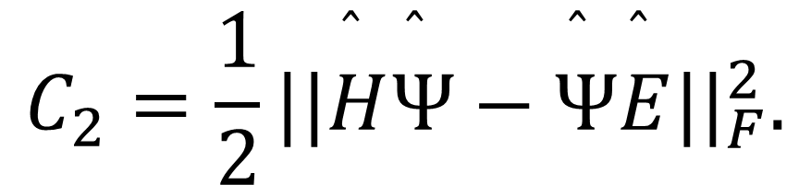
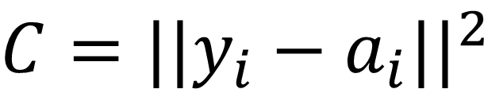
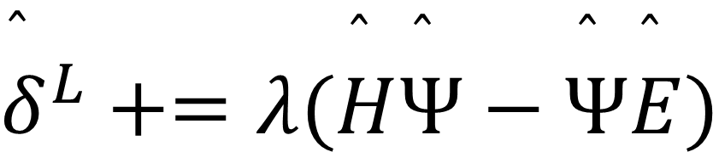
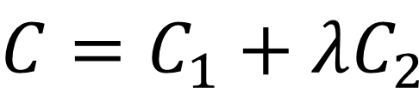
General breakdown… (anything missing?)
We need to work from same dataset to make meaningful comparisons, so to that end, we want to fix today what dataset will be used moving forward
Two manuscripts as discussed 2019-09-03 — need your input for CS
Break down three “motifs”
BB - quadratic cost
Change Cost function
Change error
$$C=C_{1}+λC_{2}$$
$$C=||y_{i}−a_{i}||^{2}$$
$${\overset{̂}{δ}}^{L}+=λ(\overset{̂}{H}\overset{̂}{Ψ}−\overset{̂}{Ψ}\overset{̂}{E})$$
$$C_{2}=\frac{1}{2}||\overset{̂}{H}\overset{̂}{Ψ}−\overset{̂}{Ψ}\overset{̂}{E}||_{F}^{2}.$$

Slide 3


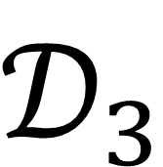
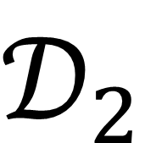
Workflow: performed for each motif (BB, C2, $δ$)
Inputs — 9 Datasets (Binary)
Output for each dataset (ASCII)
Training MSE Card
Testing MSE Card
Predictions Card
Single Phase
20k
Header - Network topology and dataset label
Header - Network topology and dataset label
Header - Network topology and dataset label
$$𝒟_{1}$$
4-site-hamil-gs.bin
train
Test
40k
60k
Dual Phase
20k
Epochs
MSE
Epochs
MSE
Field Value
$$\overset{⃗}{Ψ}$$
$$𝒟_{2}$$
4-site-hamil-gs.bin
1
1
1
train
Test
40k
2
2
2
60k
3
3
3
20k
.
.
.
Multi Phase
.
.
.
.
.
.
$$𝒟_{3}$$
4-site-hamil-gs.bin
40k
train
Test
N
N
N
60k

Slide 4



Plots needed for algorithm publication
BB
C2
BB
C2
$$δ$$
20k
MSE
$$δ$$
60k
40k
Epochs
MSE
BB
C2
Predictive
Power
$$δ$$
Floating Point operations
Epochs
Epochs
Epochs

Slide 5
Status of manuscript sections…
Algorithm Manuscript
Abstract
Introduction
Methods
Results
Discussion
Conclusion
Physics Manuscript
Abstract
Introduction
Methods
Results
Discussion
Conclusion

